Slide 1
Common eelgrass epifauna near Calvert, and a few patterns across time and space

Slide 2
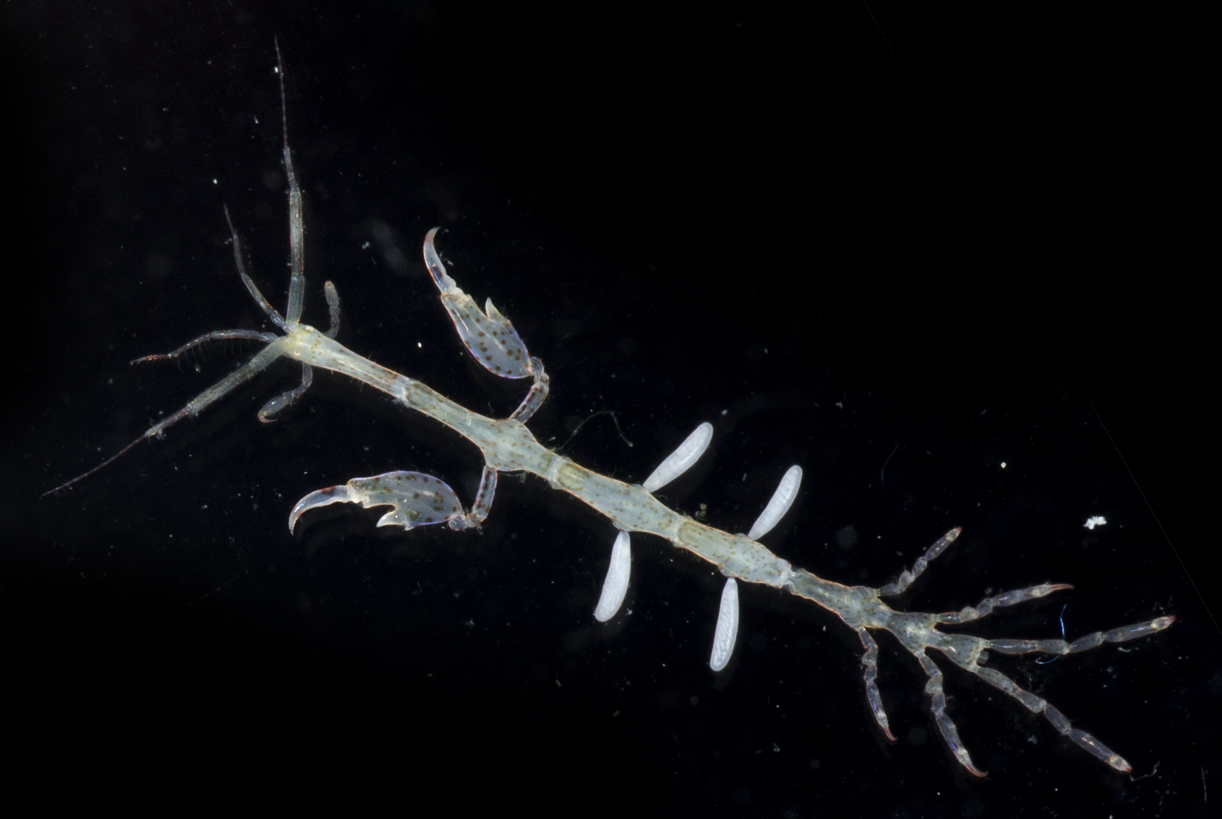
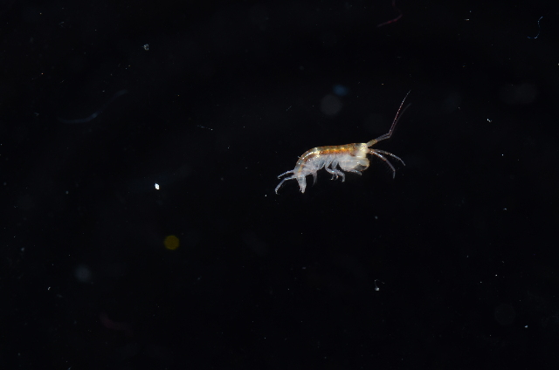
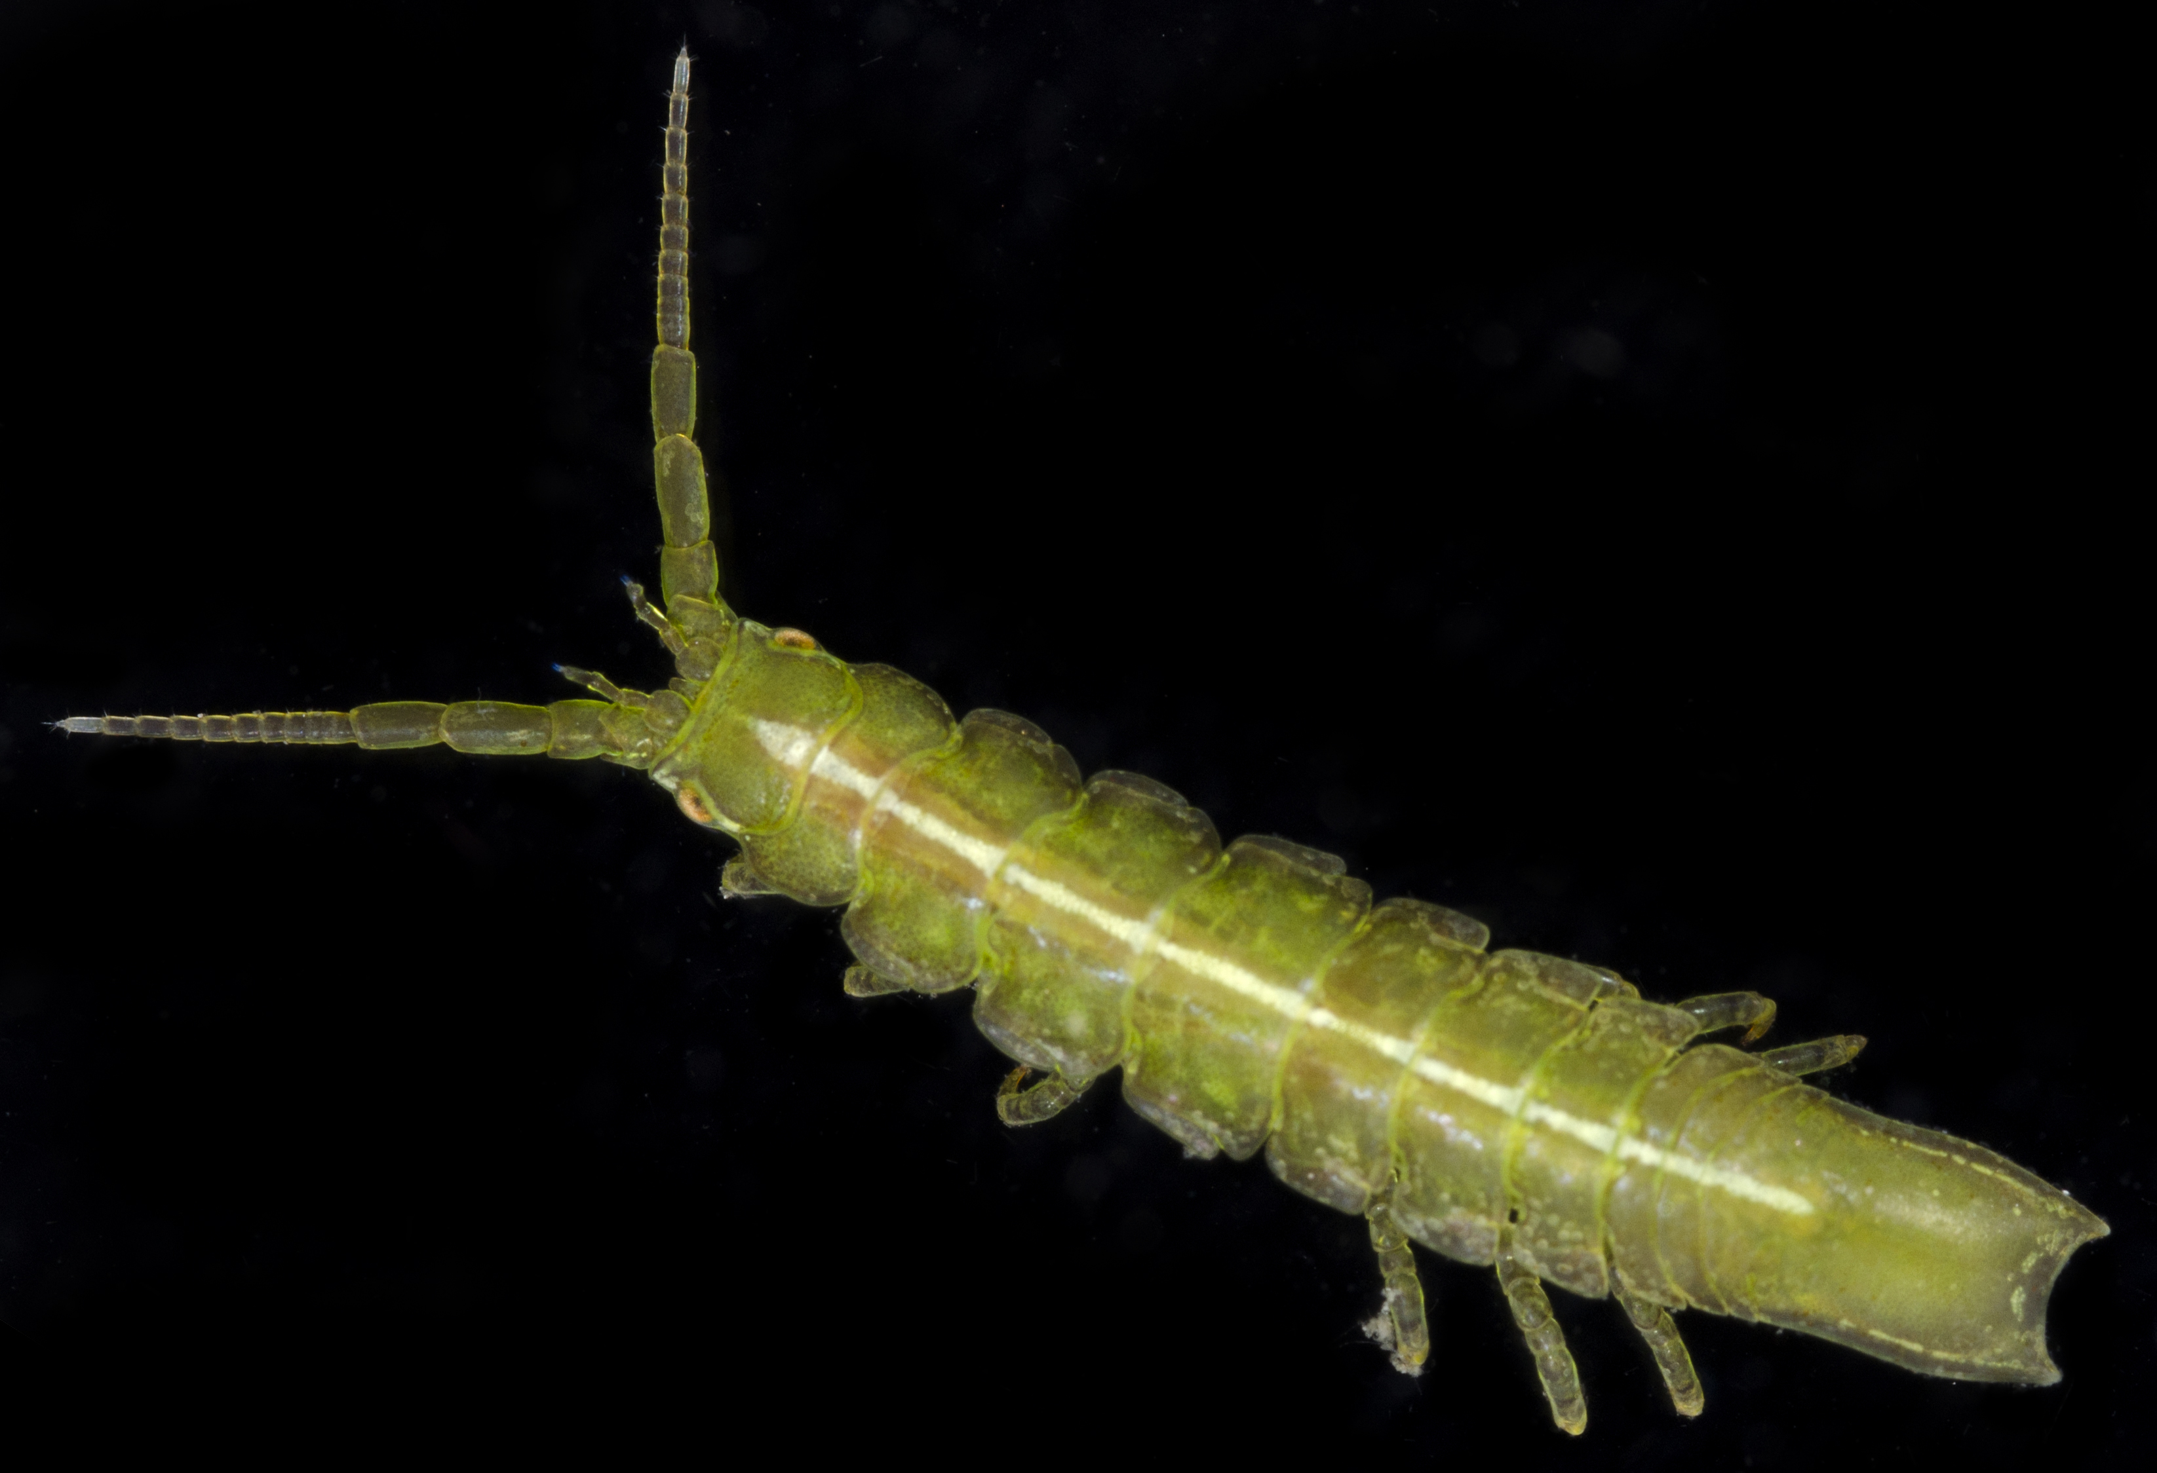
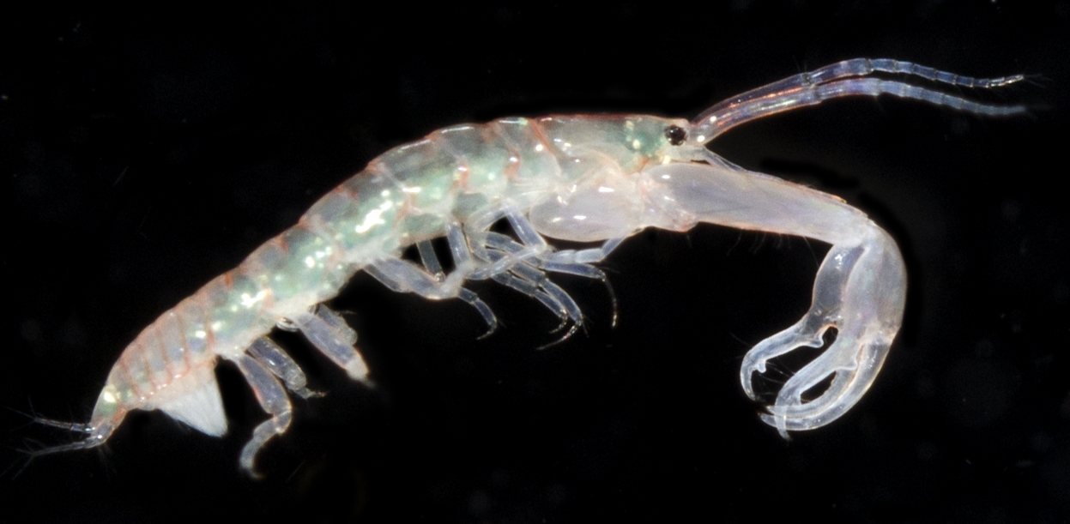
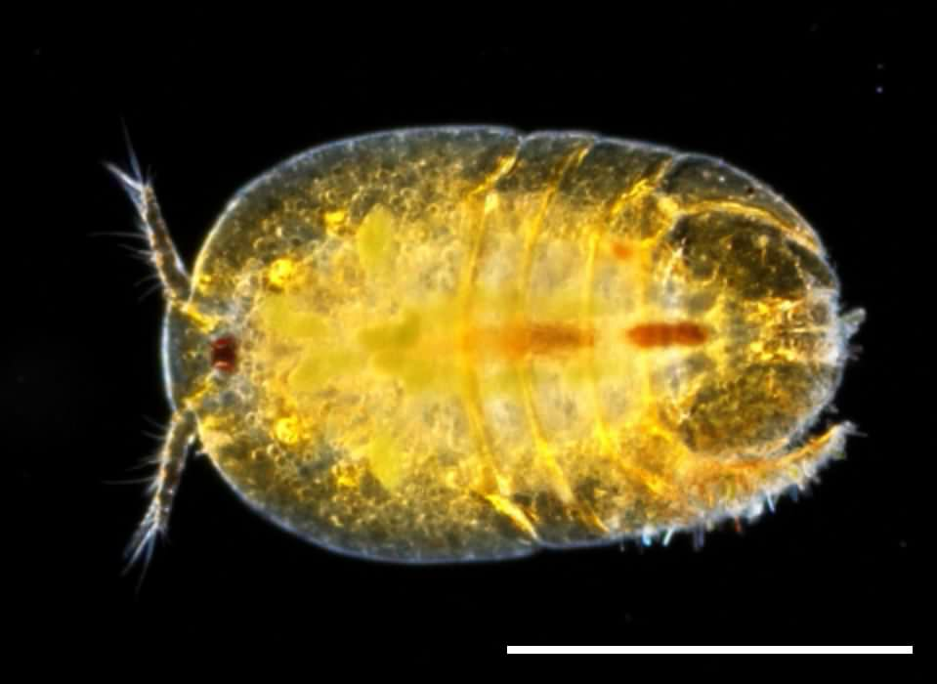
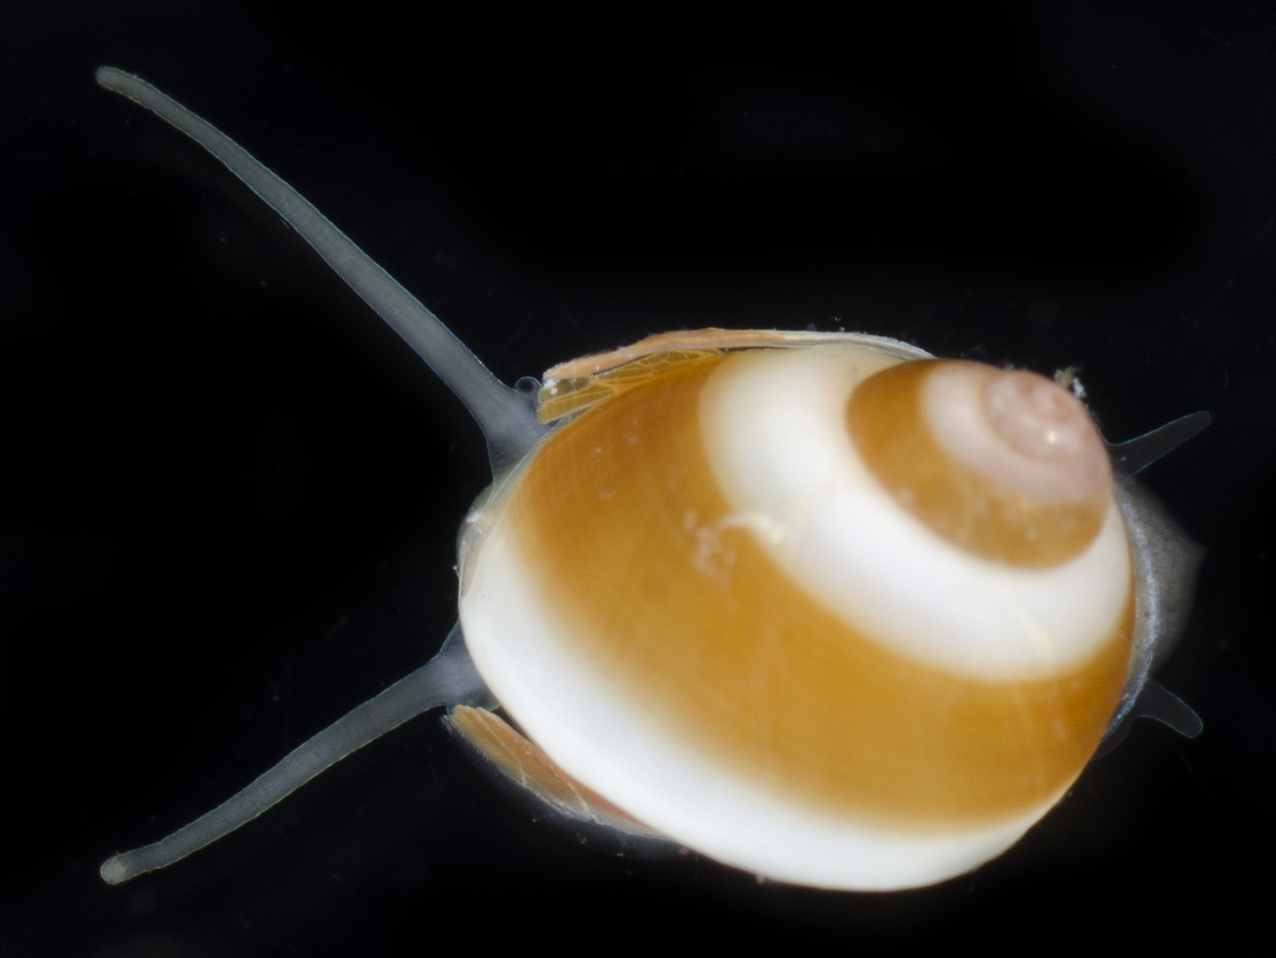
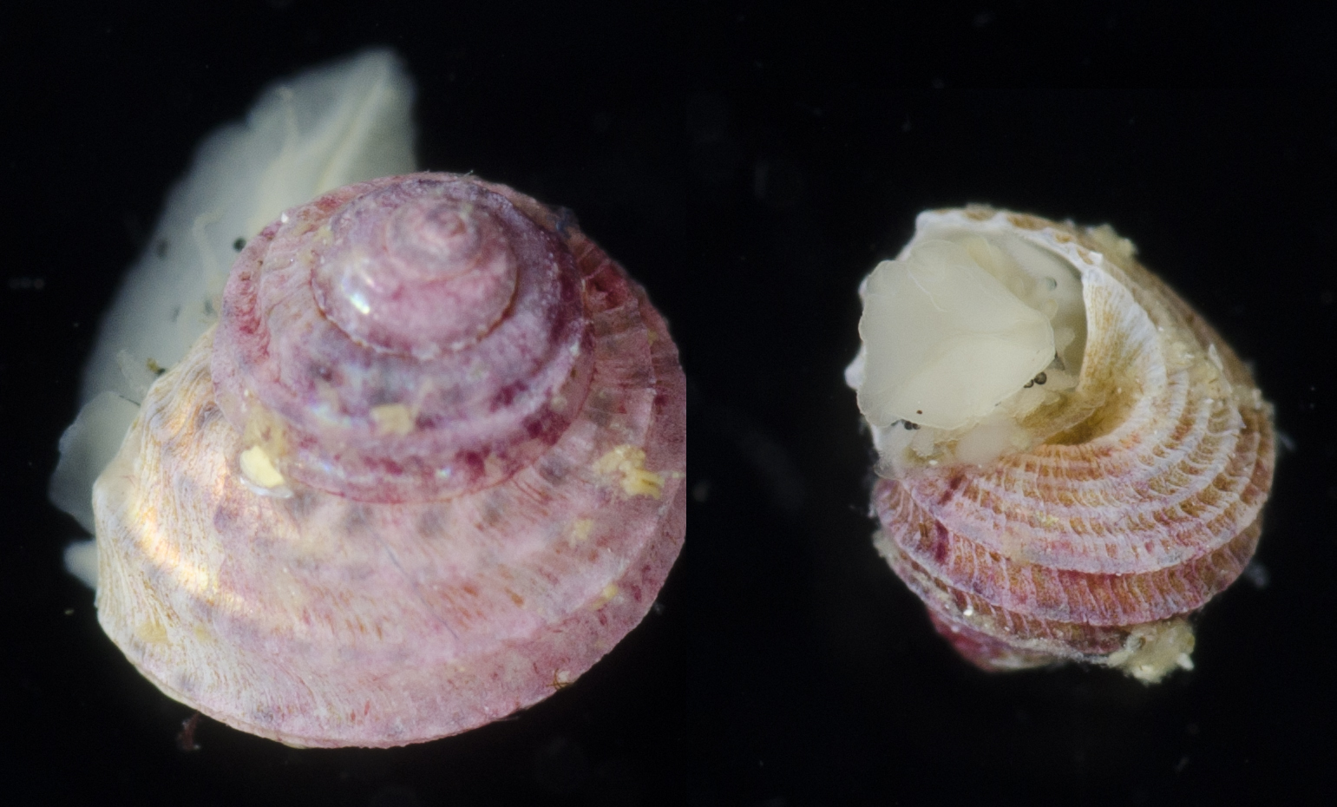
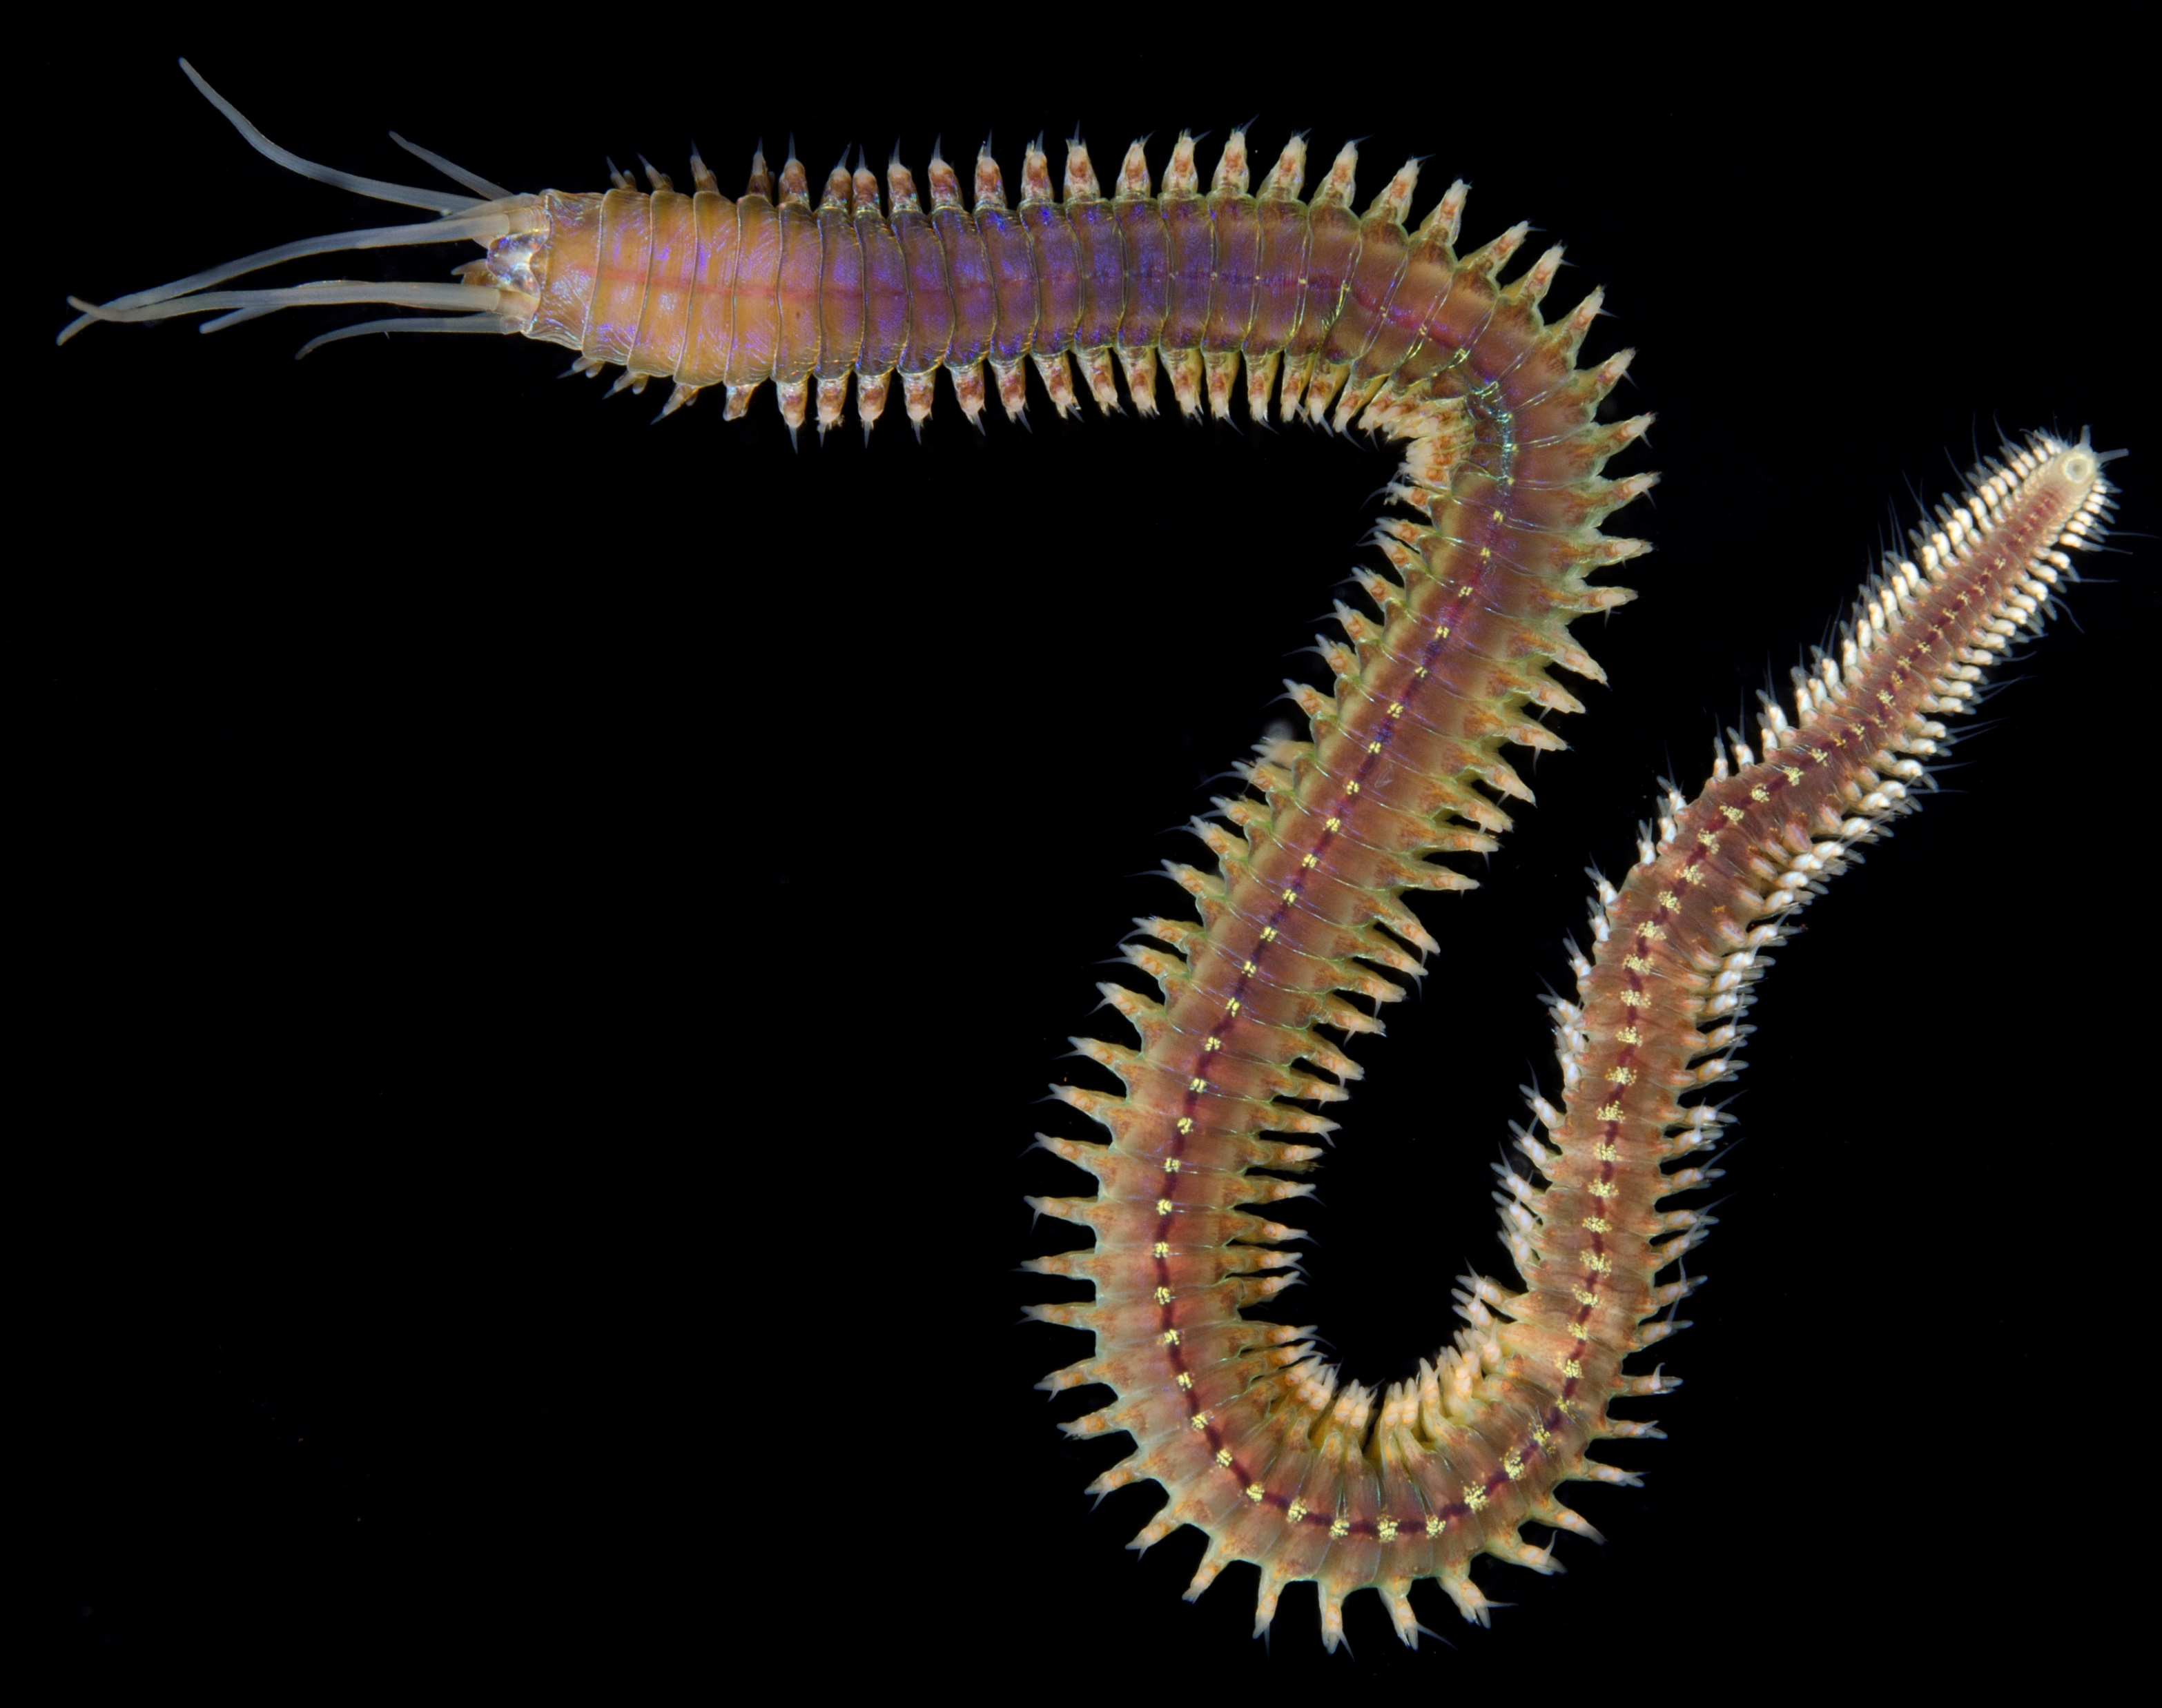
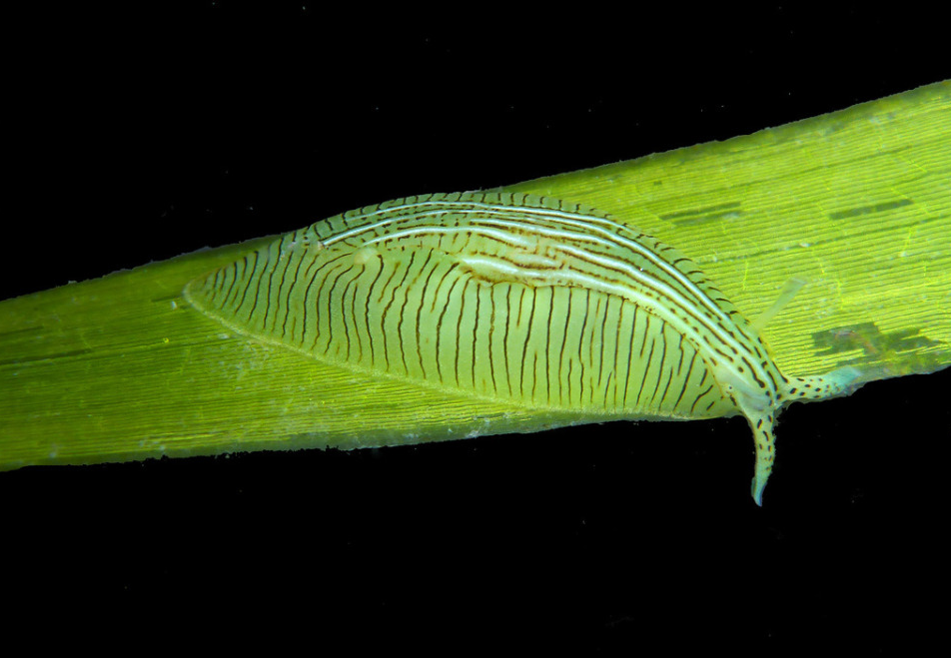
Crustaceans
“gammaridean”
Isopoda
Caprellidae
Tanaidacea
Harpacticod copepods
Peracarids
Polychaetes
Mollusks
Phyllodocida
includes nererids, phyllodocids, syllids, glycerids, hesionids, polynoids
Trochoidea
Littorinoidea
Phyllaplysia
no planktonic form
planktonic larvae

Slide 3
Crustaceans
“gammaridean”
Isopoda
Caprellidae
Tanaidacea
Harpacticod copepods
Peracarids
Polychaetes
Mollusks
DON”T LET LESLIE DOWN
Phyllodocida
includes nererids, phyllodocids, syllids, glycerids, hesionids, polynoids
Trochoidea
Littorinoidea
Phyllaplysia
no planktonic form
planktonic larvae

Slide 4

2014
2015
2016
2017

Slide 6
Rank-abundance curves for lumped taxa from 4 core sites

Slide 7
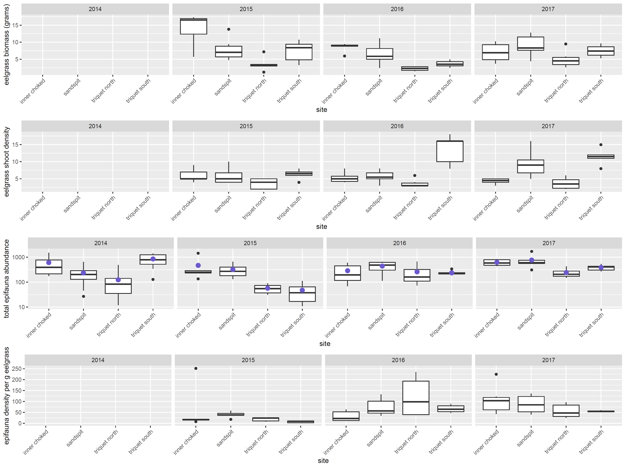
Eelgrass and epifauna summaries from 4 core sites

Slide 8
Epifauna alpha diversity indices from 4 core sites

Slide 9
Epifaunal communities from Calvert are distinct from Triquet
Epifaunal communities differ across years

